Slide 1
Cataclysmic Variable: SS cyg
A Project by andy parker

Slide 2
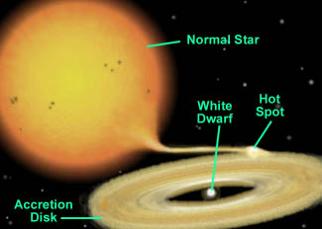
Background
Cataclysmic Variable stars are binary star pairs consisting of a white dwarf and red giant star (usually).
The white dwarf star rips away its stair pair’s matter because its gravitational pull is much greater than that of its partner.
This Phenomena causes an accretion disk to form, funneling the matter towards the white dwarfs magnetic poles.
The intense gravitational pull can cause the white dwarf to form jets of excited electrons at the poles and can create an electromagnetic field
Although we do not yet understand how or why the electromagnetic fields form

Slide 3
Purpose
I chose to research this cataclysmic variable because of the research that is being done with them in the UV and shorter wavelengths
Modern research of cataclysmic variables include: “The Physics of Accretion and Outflow” where Decastro and associates study the energy transformation in the accretion disk to one form of energy: Mechanical.
They suggest that this could phenomena could be replicated here on Earth and thus strive to do so
Propulsion Science is also heavily based on the study of cataclysmic variables in the cosmos.

Slide 4
Procedure
For this particular variable star I used the 12” telescope with a monochrome CCD imager. I did not use filters for imaging this object.
My exposure times varied from 4 seconds – 45 seconds the magnitudes were 7.7 and 8.7
I processed my data from each night using CCD soft.
After my Science images were calibrated I then plugged them into AstroimageJ to create a light curve for each night

Slide 5
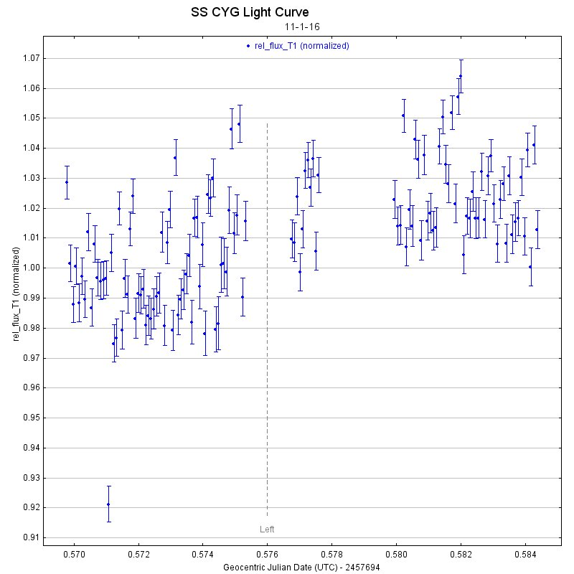
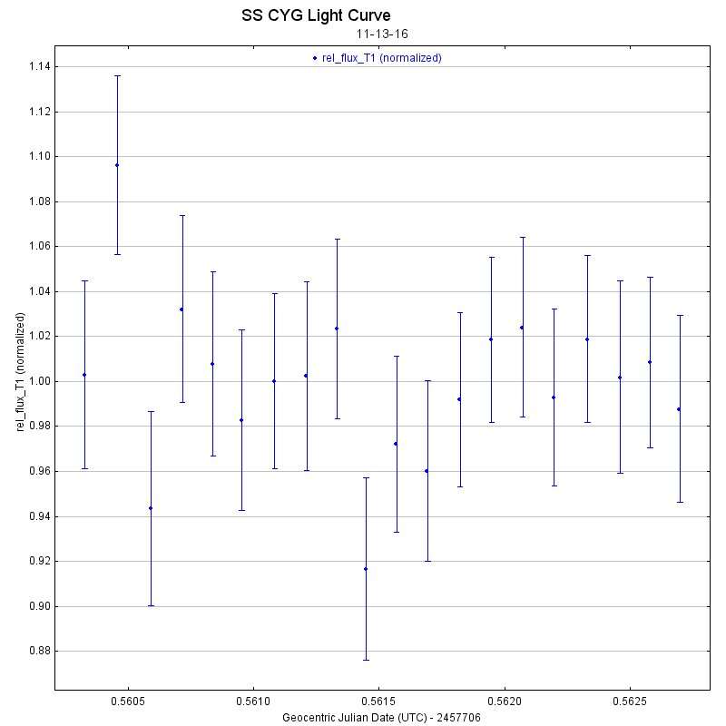
Results and other images
Graphs:
11-1-16
11-13-16

Slide 6
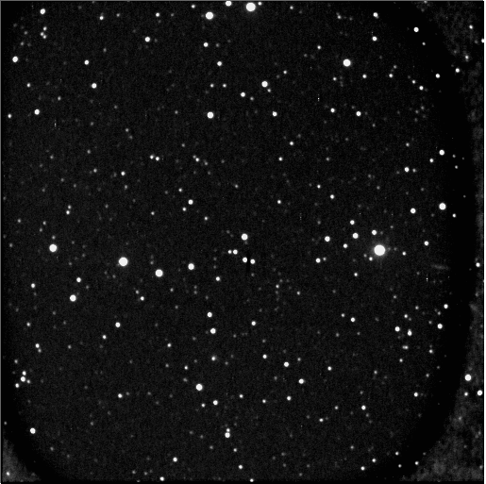
Final Images
11-1-16 (outburst)
11-13-16 (quiet)

Slide 7
Conclusion
I originally planned to create a Magnitude vs. Date graph to attempt to show the variable star’s fluctuation in magnitudes however two nights of usable data does not suffice for a graph
So instead I created light curves for both of the nights I observed and processed both images to show a slight change in magnitude
Although they are not true quiet (lowest magnitude) photos and outburst (peak magnitude) both images have different magnitudes

